Slide 1
PREDICTING THE SEVERITY OF
CAR ACCIDENTS
IN SEATTLE

Slide 2
Business Understanding-
The Seattle Government is going to prevent frequent road accidents by suggesting and implementing methods that alert drivers, health system, and police to remind them to be more careful in critical situations.
In most cases, not paying enough attention during driving, abusing drugs and alcohol or driving at very high speed are the main causes of occurring accidents that can be prevented by enacting harsher regulations. Besides the aforementioned reasons, weather, visibility, or road conditions are the major uncontrollable factors that can be prevented by revealing hidden patterns in the data and announcing warning to the local government, police and drivers on the targeted roads. In an effort to reduce the frequency of car collisions in a community, an algorithim must be developed to predict the severity of an accident given the current weather, road and visibility conditions. When conditions are bad, this model will alert drivers to remind them to be more careful.The target audience of the project is local Seattle government, police, rescue groups, and last but not the least, car insurance institutes.

Slide 3
DATA ACQUISITION AND CLEANING-
1. Collisions data from 2004 to present.
2.Seattle Map data
We would drop those unrelated features and useless information, only keep 15 features/attributes of the original dataset.Missing values are replaced by frequency/ whole columns should be dropped only if most entries in the column are empty.Also some of the data format was corrected.

Slide 4
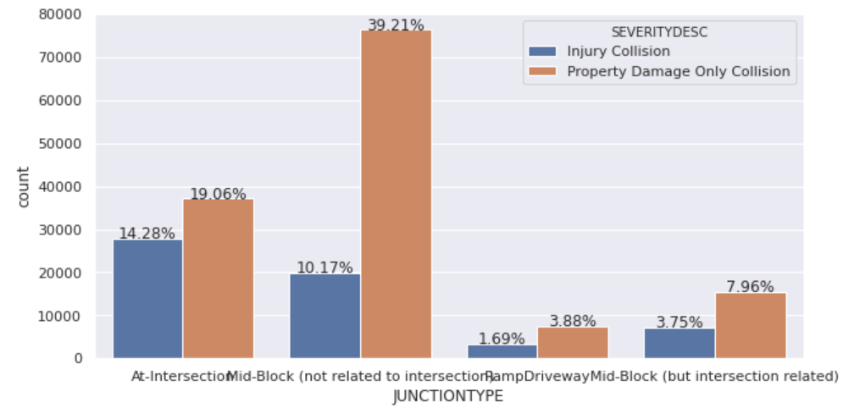
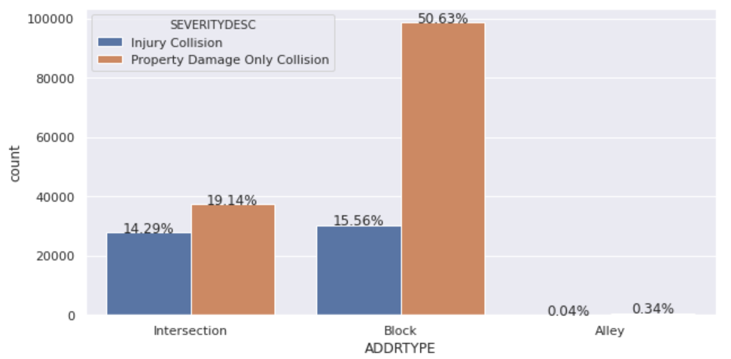
DATA ANALYSIS (ANALYZING INDIVIDUAL FEATURE PATTERNS USING VISUALIZATION)-

Slide 5
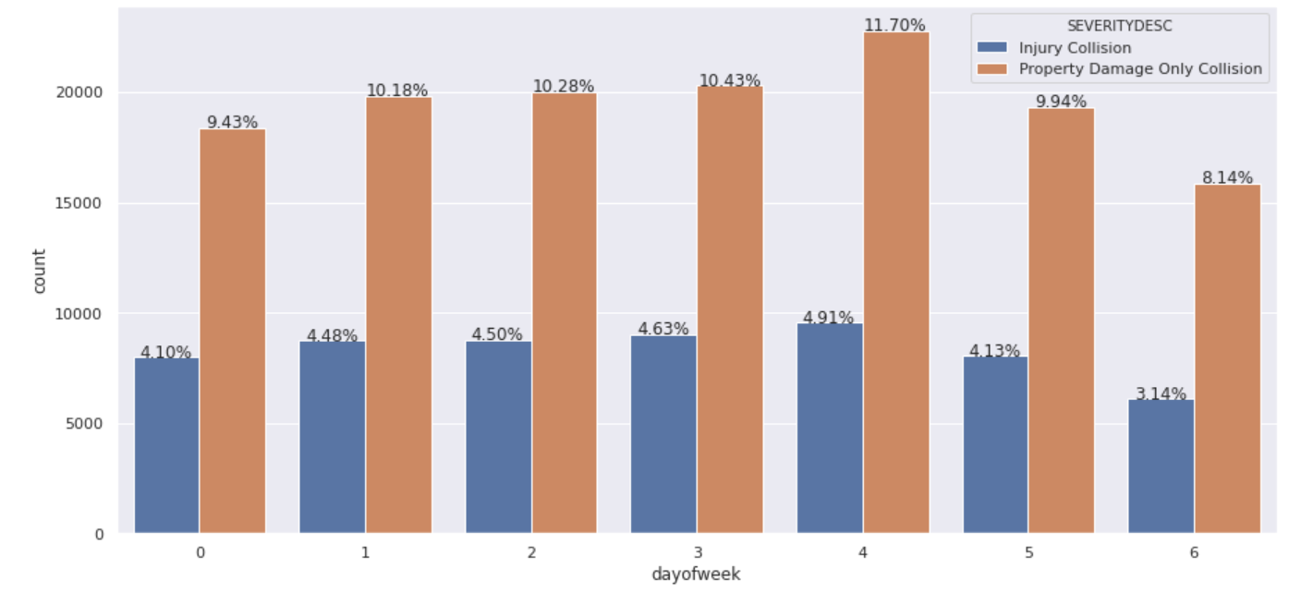
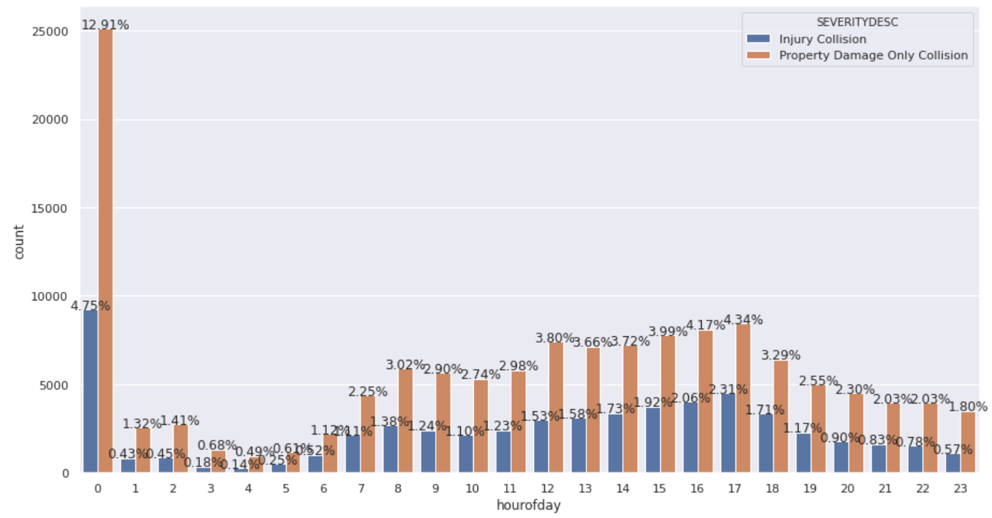

Slide 6
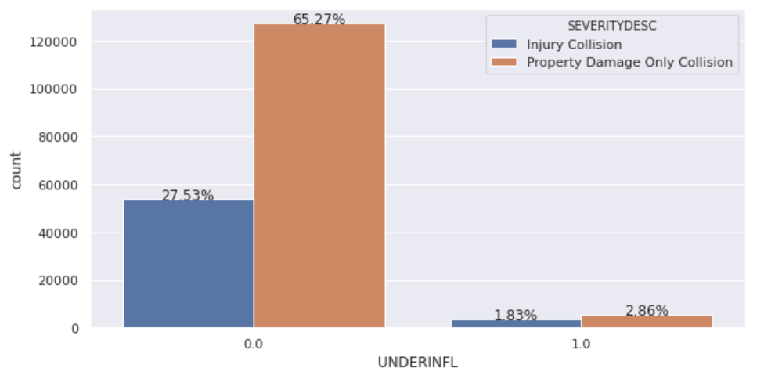
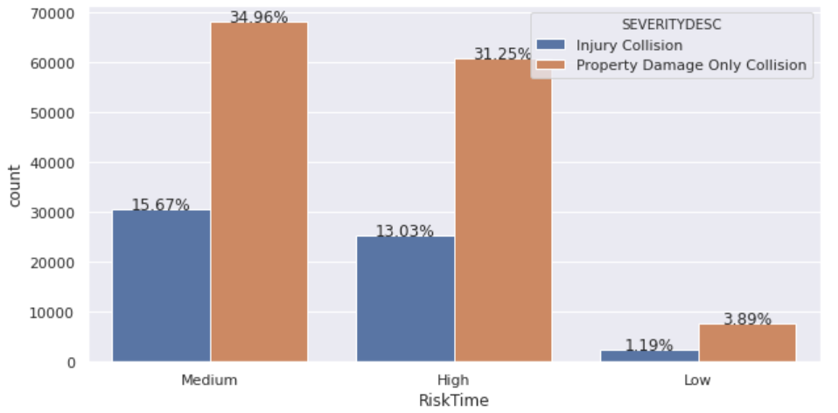

Slide 7
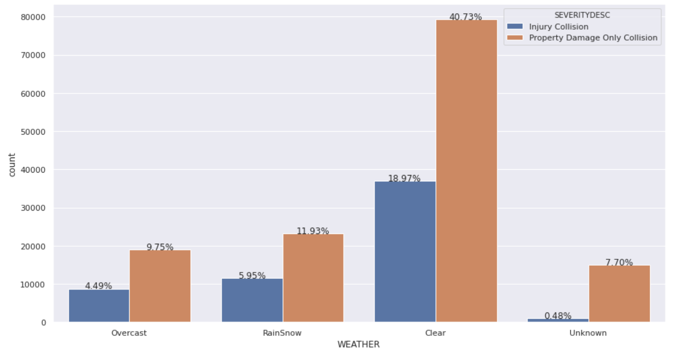
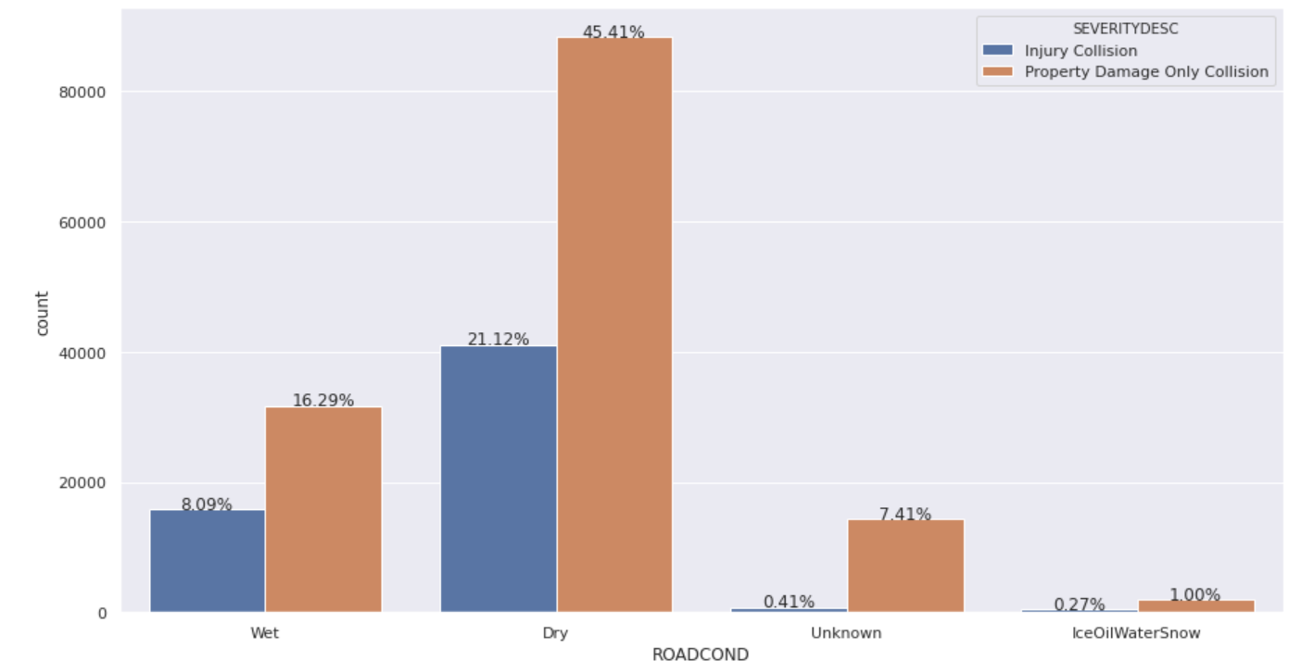
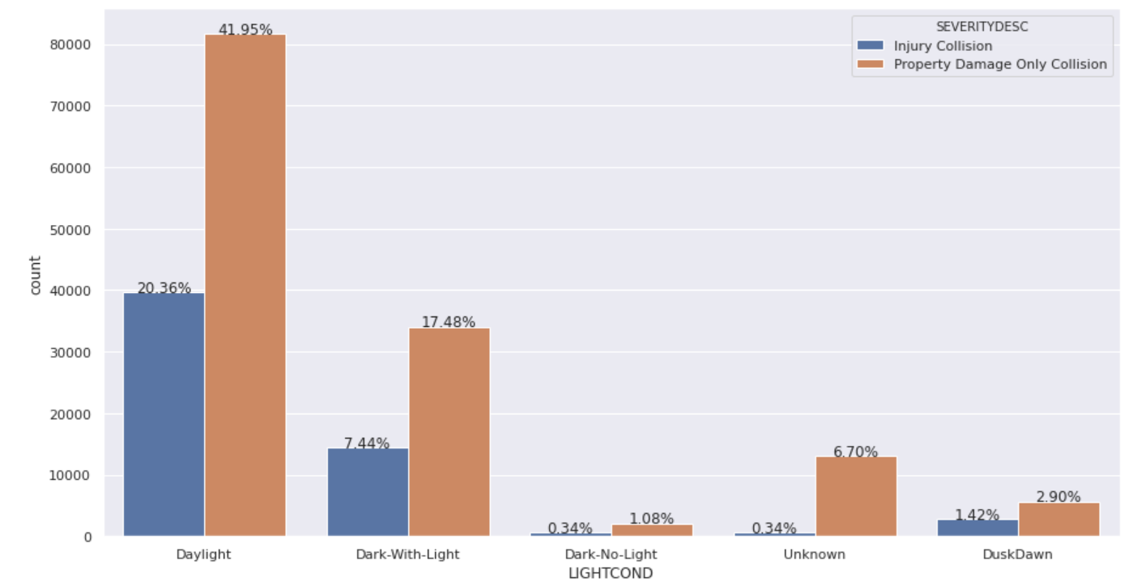

Slide 8
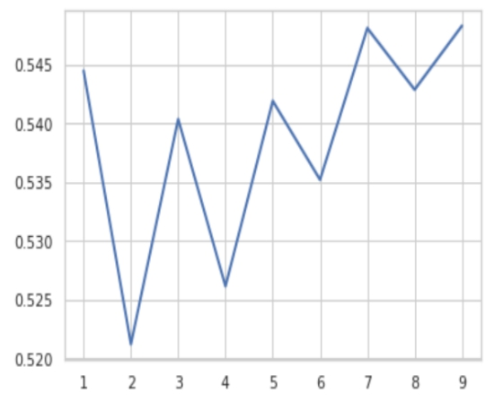
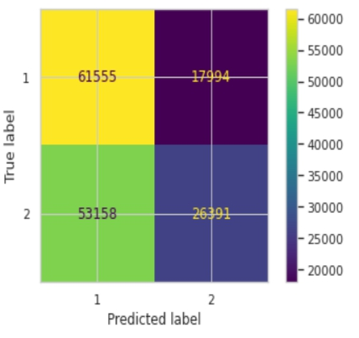
METHODOLOGY-
K-NEAREST NEIGHBOR- The best K, as shown below, for the model where the highest elbow bend exists is at 9.

Slide 9
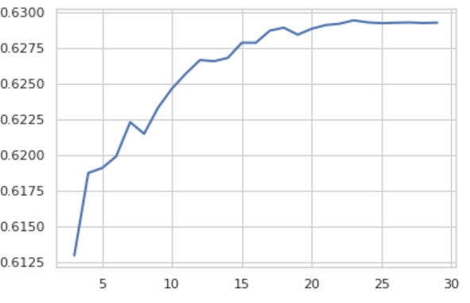
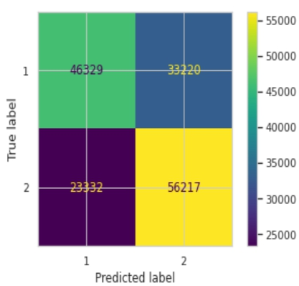
DECISION TREE ANALYSIS- The criterion chosen for the classifier was ‘entropy’ and the max depth was 23 with best accuracy of 63%.

Slide 10
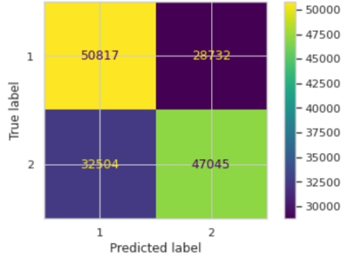
LOGISTIC REGRESSION- We use GridSearchCV to search the best parameters. The C used for regularization strength was ‘0.01’ and penalty was “l2”, whereas the solver used was ‘liblinear’.

Slide 11
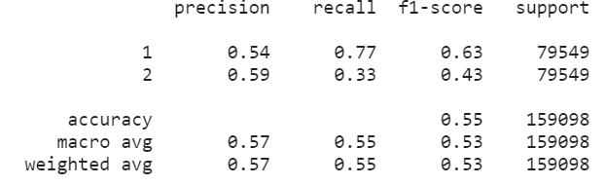
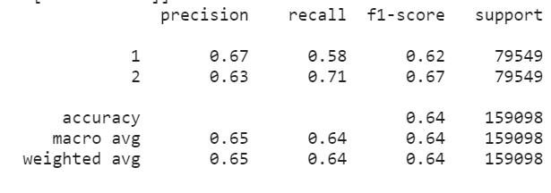
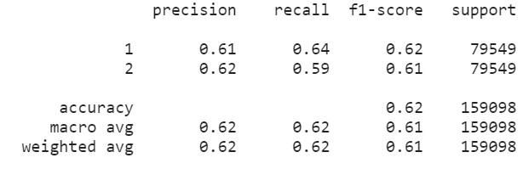
RESULT-
K-NEAREST NEIGHBOR-
DECISION TREE ANALYSIS-
LOGISTIC REGRESSION-

Slide 12
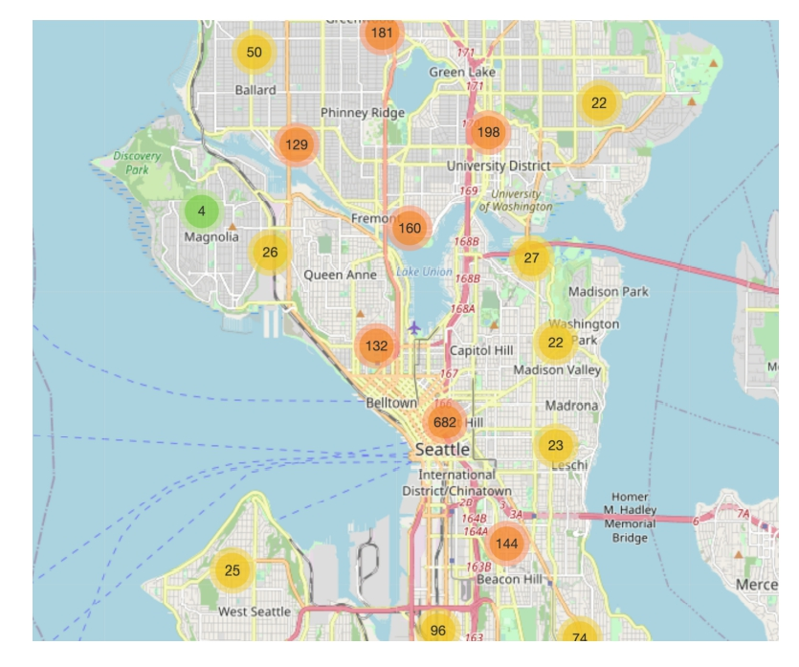
RECOMMENDATIONS-
The map below shows 5% of all the “Injury Collision” in Seattle area since 2004 to present, which can give you an idea of where you should drive more carefully than other places.

